Slide 1
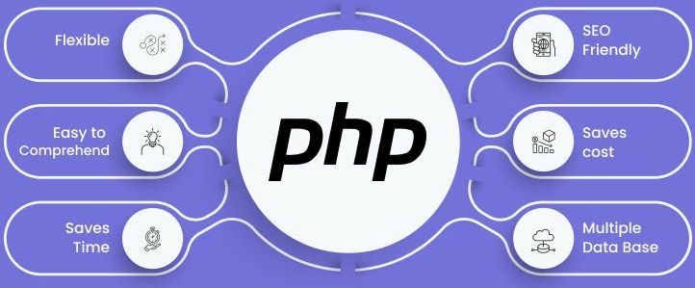

Slide 2
About today…
External API Integration
Fetch data
Send data

Slide 3

Working with external APIs

Slide 4
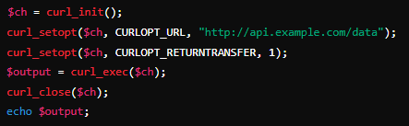

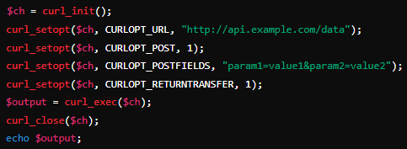
Handling GET Requests
Handling POST Requests

Slide 5

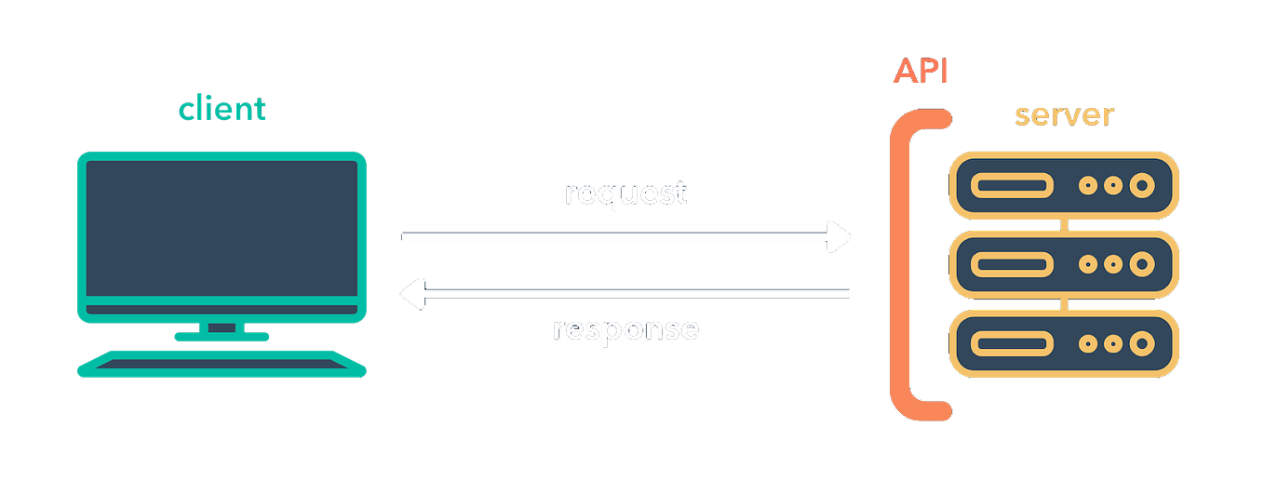
Handling API Responses
Reading Response Data
Use curl_exec() to fetch the response from the server
Handling JSON Responses
Convert JSON response to PHP associative array using json_decode()
Example

Slide 6

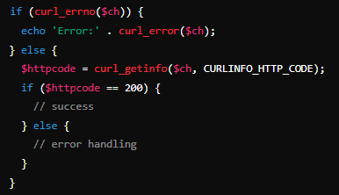
Error Handling
Check if cURL executed successfully using curl_errno()
Handle different HTTP status codes to determine if the request was successful or if errors occurred

Slide 7
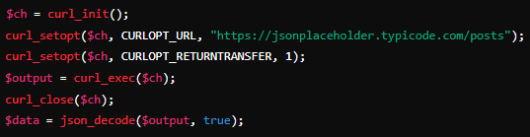


Example: Fetching Data from an API
Choosing an API
Select a public API for demonstration, such as JSONPlaceholder or OpenWeatherMap
Making a GET Request
Parsing and displaying data

Slide 8

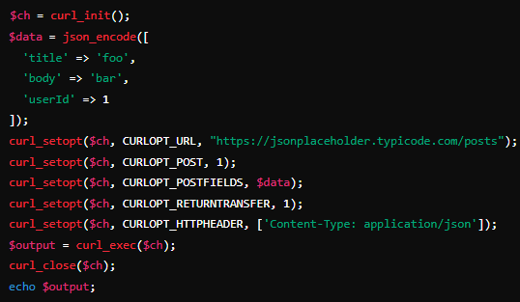
Example: Sending Data to an API
Choosing an API
Use JSONPlaceholder for testing POST requests
Making a POST Request
Sending Data in JSON Format
Ensure data is properly formatted as JSON

Slide 9


Slide 10

Which PHP function is commonly used to make HTTP requests to an API?
curl_exec()
What is the purpose of the curl_init() function in PHP?
Initialize a cURL session
What HTTP status code indicates a successful API request?
200

Slide 11

Task 1
Practice accessing data from an external API

